Slide 1

Fiddler
Presented by
Dmitro Malikov

Slide 2
Capture of traffic

Slide 3
Typical architecture

Slide 4
Debugging between devices
PC
Mac
Fiddler
Internet
SmartPhone
Linux

Slide 5
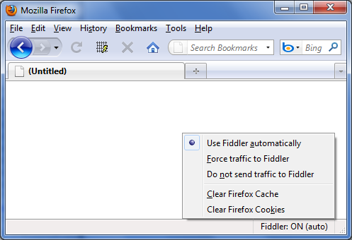
FiddlerHook for Firefox

Slide 6
Traffic import

Slide 7
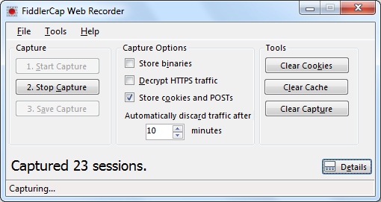
FiddlerCap
FiddlerCap – is the utility for capturing of traffic

Slide 8
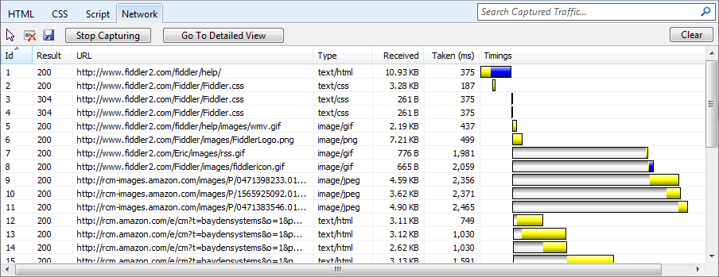
IE9 Developer Tools
IE9 Developer Tools includes the tab "Network"

Slide 9
Traffic analysis

Slide 10
Filtering of traffic
Ignoring images
Filter by Application Type
Filter Process
Using QuickExec
Search usage

Slide 11
Save options
Copying sessions into the clipboard
Saving in a flat text file
Export binary content requests
Stored in the database
Export as Web studio test
Writing your own engine .... (Fully scriptable)
The original storage format sessions
"Session Archive ZIP" (SAZ)

Slide 12
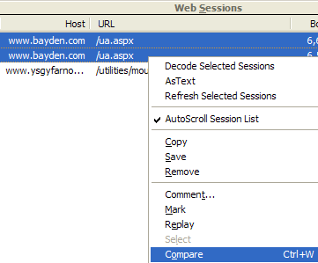
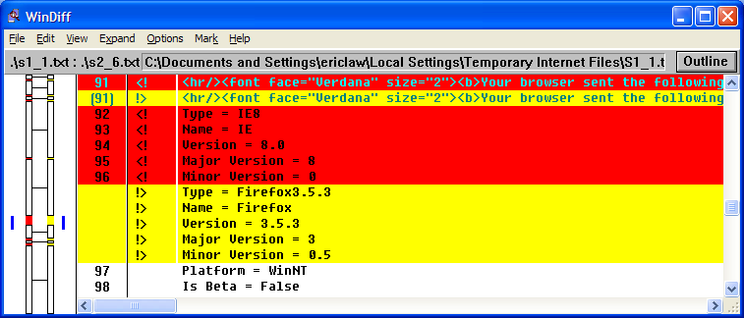
Comparison of traffic
Use WinDiff to compare requests and responses

Slide 13
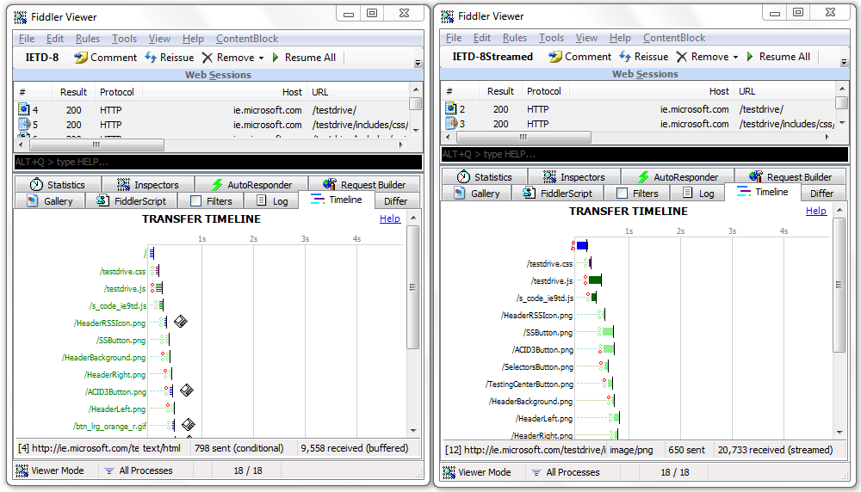
Comparison of traffic
View mode allows you to analyze the set of grippers

Slide 14
Traffic modification

Slide 15
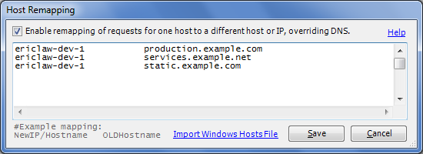
Automatic rewriting
Simple built-in rules
Expansion HOSTS

Slide 16
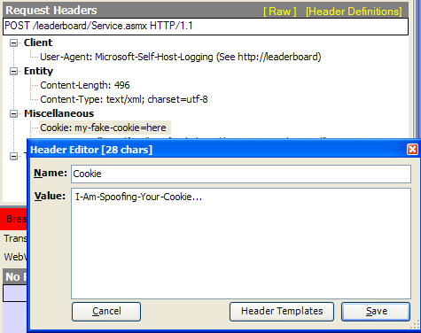
Debugging
Using Fiddler inspectors to modify requests and responses

Slide 17
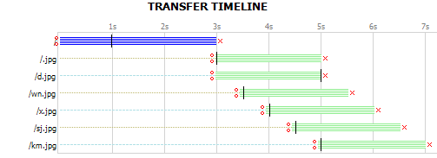
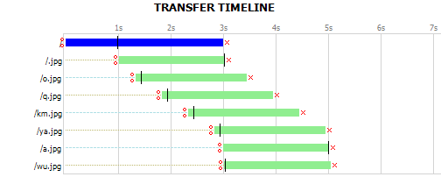
Strimming
Timeline in buffering mode:
Timeline in streaming mode:

Slide 18
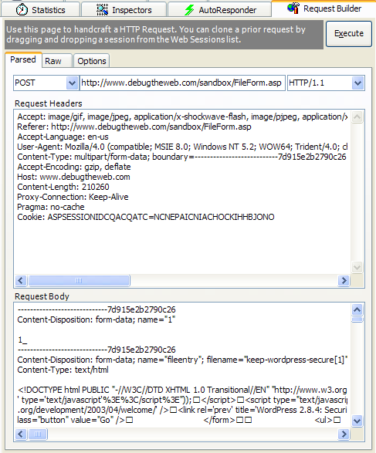
Request Builder
Manually create HTTP requests, or modify and restart the previously captured requests.

Slide 19
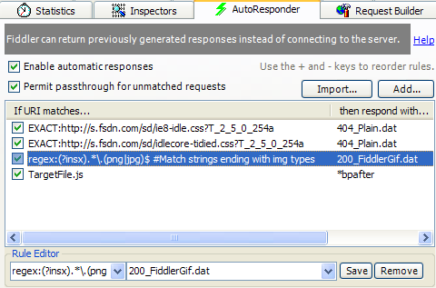
AutoResponder
Playing a pre-captured or generated by traffic.

Slide 20
FIDDLERSCRIPT

Slide 21
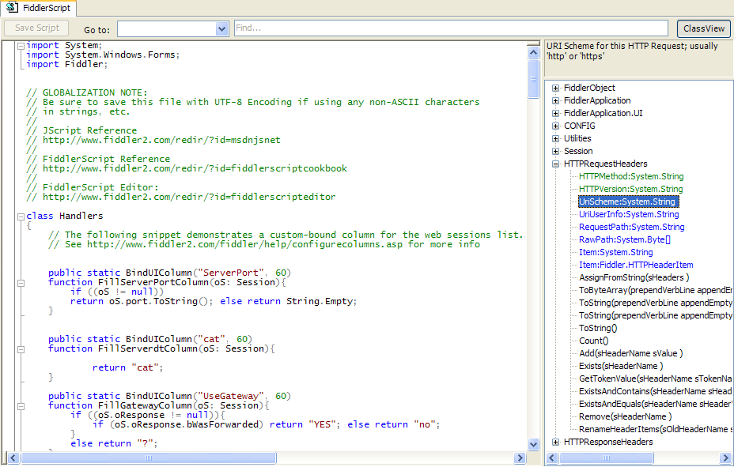
FiddlerScript

Slide 22
FiddlerScript
Modification request
Static function OnBeforeRequest(oS: Session)
{
if(oS.uriContains(“.aspx”))
{
oS[“ui-color”] = “red”
}
if(m_DisableCaching) {
oS.oRequest.headers.Remove(“If-None-Match”);
oS.oRequest.headers.Remove(“If-Modified-Since”);
oS.oRequest[“Pragma”] = “no-cache”;
}
}

Slide 23
Expansions

Slide 24
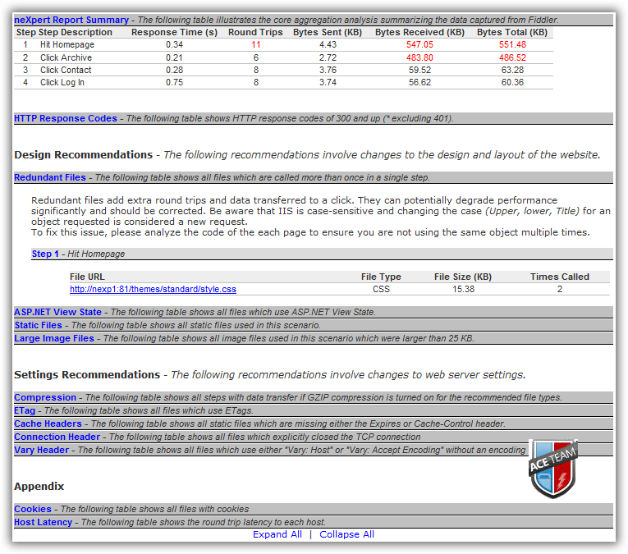
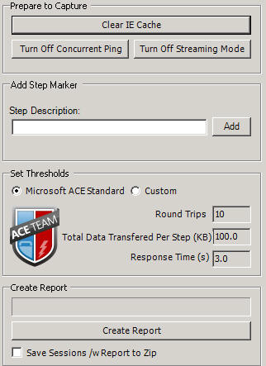
neXpert

Slide 25
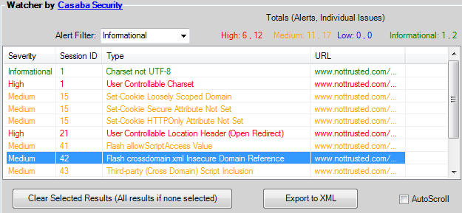
Watcher
Automated (passive) security analysis

Slide 26
The end

